Slide 1
Strategic Positioning
Chapter 2

Slide 2
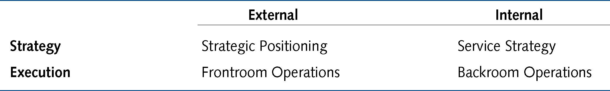
Strategic Positioning and Service Strategy

Slide 3
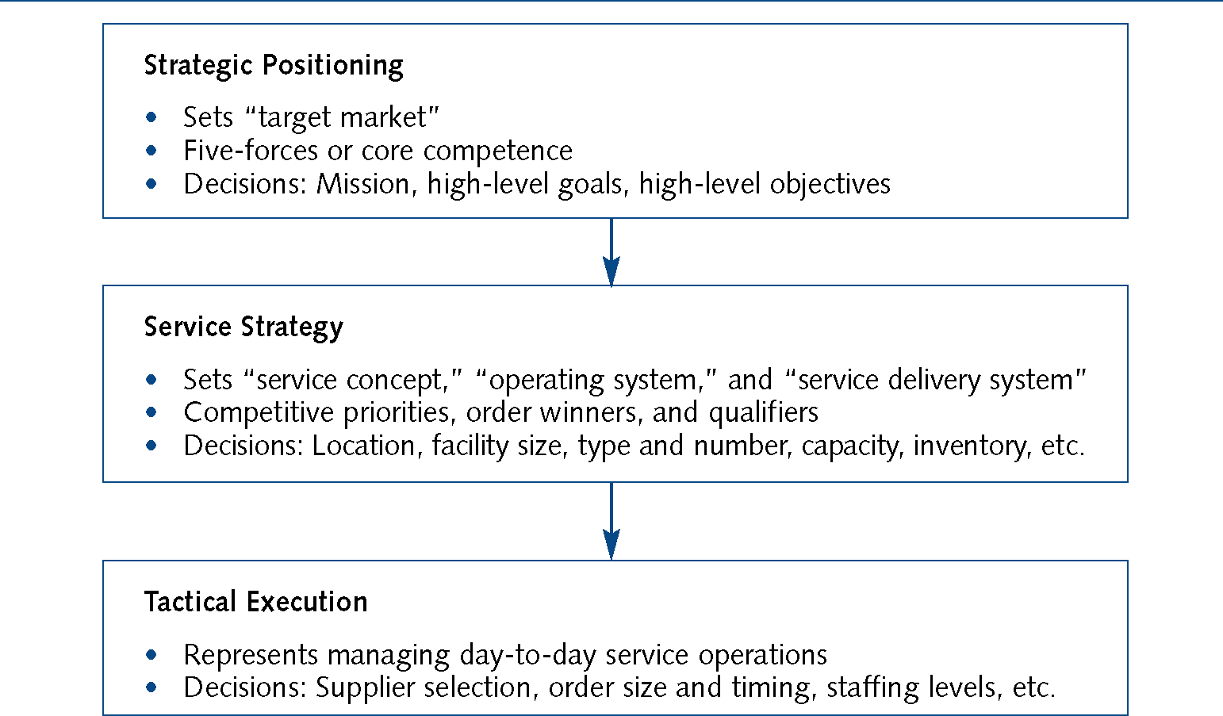
The Strategic Planning Process for Services

Slide 4
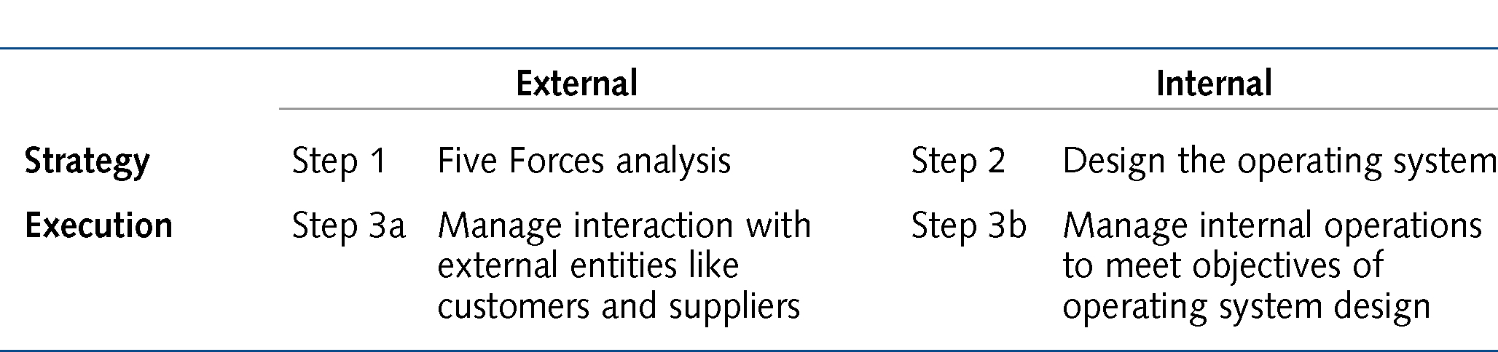
Industry/Competitor Analysis Approach to Strategic Consistency

Slide 5
Strategic Service Vision
Target market
  May result in different treatment of different customers
  All employees must understand target market
Service concept
  Why customers choose a particular firm
    Motivation can be emotional or physical

Slide 6
Strategic Service Vision
Operating strategy
  How should the firm be structured to produce the service concept?
  How should resources be allocated?
Service delivery system
  Specific decisions made by the firm regarding personnel, procedures, equipment, capacity, facilities, etc.

Slide 7
Strategic Service Vision
Ideally, a service delivery system should support the operating strategy, which should support the service concept, which supports the target market
Target Market
Service Concept
Operating Strategy
Service Delivery System

Slide 8
Managing for Growth
Multi-site Service Firm Life Cycle
Entrepreneurial
Multi-site
Rationalization
Growth
Maturity
Decline/
Regeneration

Slide 9
Managing Growth – Skill Sets
Entrepreneurial | Multi-site rationalization | Growth | Maturity | Decline/ Regeneration
Charismatic leader Local marketing and PR Innovation and development of service strategy Employees typically underpaid with little stability | Selection of dominant paradigm for marketing, operations and HR Standardization or procedures | Operations and design are already set Sell concept to consumer and managerial audiences Wider scale advertising | Maintaining market position and awareness and keeping concept “fresh” Maintaining standards and operating control Keeping employees motivated | Revising service concept and implementing revisions over a large network Requires charismatic leader

Slide 10
Growth Strategies
Industry Roll-Ups
  Use stock to buy up dozens of small firms in a fragmented industry
  Gain synergies when once-competing firms share facilities, supplies, marketing expenses and operational expertise

Slide 11
Franchising
A self-financing growth strategy
  Franchisees pay an up-front fee and a percentage of gross revenue
Can limit profitability because a large portion of the profits go to the franchisee
  Firms may buy back mature franchises
Common in international expansion
  Bypass “ethical walls”/US Foreign Corrupt Practices Act

Slide 12
Challenges of Franchising
Channel conflict
  For example, retail outlets may oppose the introduction of on-line channels
Operational control issues
  Franchisees may oppose changes initiated at the firm level
  Franchisers cannot dictate retail prices or require that franchisees purchase supplies from the franchiser
Franchisers providing on-going value

Slide 13
Chapter Summary
The strategic planning process for services is formulated as a hierarchical model that includes:
  strategic positioning, service strategy, and tactical execution
Services strategy decisions link the strategic position of a firm to its day-to-day tactical execution

Slide 14
Chapter Summary
Growth strategies include industry rollup or franchising

